Slide 1
Lab Assignment # 6 Introduction & Reference Page
PSY 15
Mandy Small
March 3, 2021

Slide 2
Instructions
Submitting 3 pieces of your project proposal
Title Page
Introduction Section
Reference Page
Assignment #6 is worth 30 points
Your grade will be based on required components plus proper APA format + writing style (grammar, clarity, formal writing, etc.)

Slide 3
Title Page
The title page is one page (on a separate page). It includes
Full title of your proposal
Your name
Your affiliation (University of California, Merced)
The course number and name (PSY 15: Research Methods)
The course instructor’s name and title (Dr. Haiyan Liu)
The assignment’s due date (March 31, 2021)
A page number (which also appears on the following pages).
New formatting in 7th Edition APA
Student vs Professional paper
Purpose
In Peer Review

Slide 4
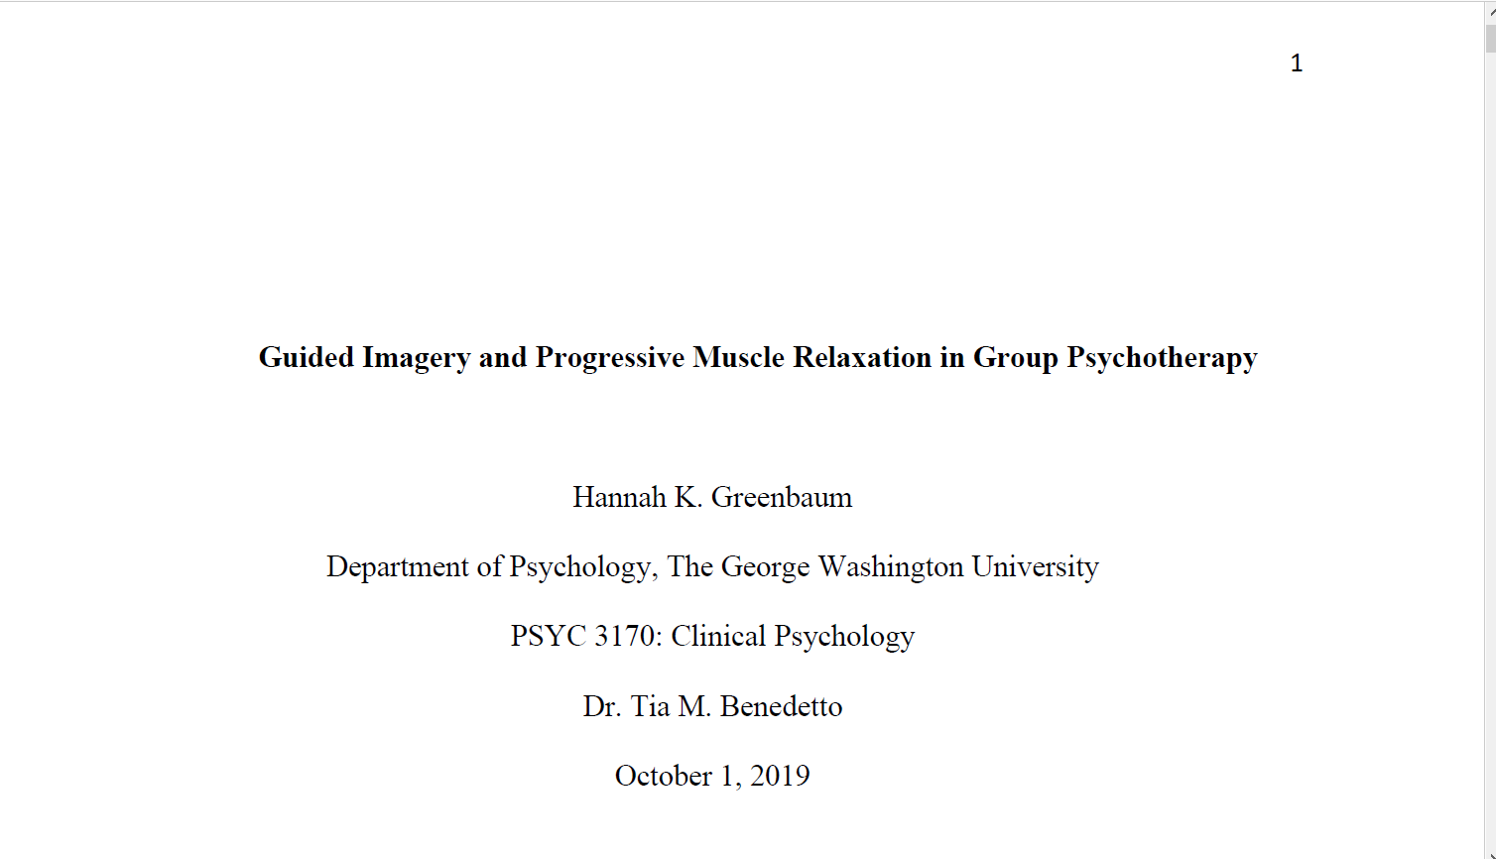
Page number in the header beginning on the title page
The paper's title should be centered, bold, and written in title case. It should be three or four lines below the top margin of the page.
Author name is written below the title, with one double-spaced blank line between them. Names should be written as follows:
First name, middle initial(s) (optional), last name.
Authors' affiliations follow immediately after their names. Then the number and name of the course, the instructor's name and title, and the assignment's due date.

Slide 5
Some Thoughts About Titles
A great title summarizes the main idea of the paper.
A great title has a length of 12 words or fewer.
A great title includes only words that contribute meaning. Phrases such as “A Study of,” “An Experimental Investigation of,” or “The Results of” are like empty calories (not unlike most of what’s in that Red Bull
A great title gives away the ending. If your title is in the form of a yes–no question, try rephrasing it so that the question is answered or the answer at least alluded to.
A great title says it with style and is distinct to your paper.

Slide 6

Introduction
Purpose:
Introduce the topic and make clear the importance of studying this topic
Review relevant studies that have already been conducted on this topic and discuss the relevant theories, when necessary - this is the bulk of the introduction
Justify why your proposed study is important (and why you designed it the way you did)
State the purpose of the study
“This study will……..
State your hypothesis for the outcome of your study (based on previous research)****
Formatting consistent with APA guidelines (check the manual!!!)
Including 12 pt font, Times New Roman, double spaced
At least 800 words long

Slide 7
***Referring To Past Research
Previous research is a critical part of a good introduction
How do we do that?
Paraphrase vs quotations
Giving credit
In-Text Citations - Credit author and date of publication (check the APA manual for formatting rules!)
For every in-text citation in your paper, there must be a corresponding entry in your reference list.

Slide 8
Example
A few researchers in the linguistics field have developed training programs designed to improve native speakers' ability to understand accented speech (Derwing et al., 2002; Thomas, 2004). Their training techniques are based on the research described above indicating that comprehension improves with exposure to non-native speech. Derwing and colleagues (2002) conducted their training with students preparing to be social workers, but note that other professionals who work with non-native speakers could benefit from a similar program.
Derwing, T. M., Rossiter, M. J., & Munro, M. J. (2002). Teaching native speakers to listen to foreign accented speech. Journal of Multilingual and Multicultural Development, 23(4), 245-259. https://doi.org/10.1080/01434630208666468

Slide 9
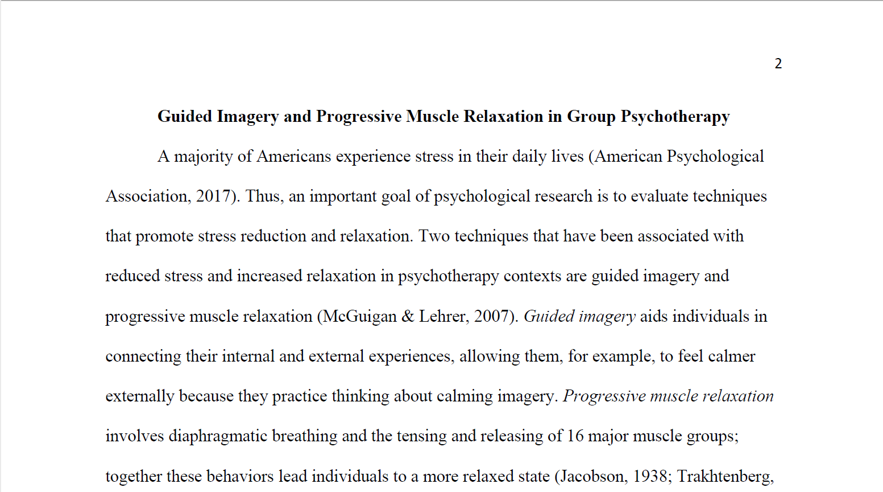
The paper's title is bolded and centered above the first body paragraph. There should be no "Introduction" header.
Here’s an example of an intext citation, which include authors’ surname and publication year.

Slide 10
Reference List
Purpose:
Connects the reader to the original literature
Every entry should match at least one in-text citations (if you didn’t cite it, then you probably didn’t use it)
Formatting consistent with APA guidelines (check the manual!!!)
Starts on a new page and is where you list your references.
You must have at least 5 references and you should use proper APA formatting.

Slide 11
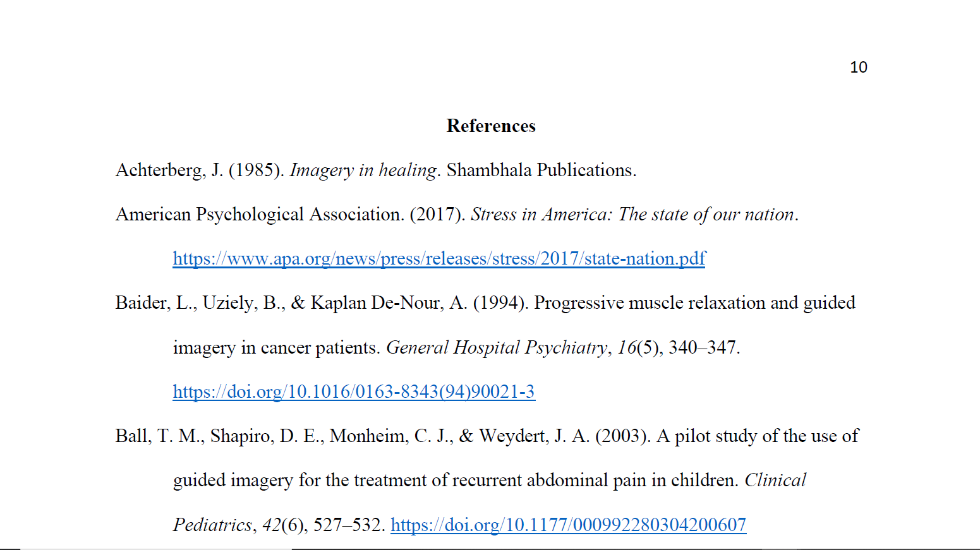
Start the references list on a new page. The word "References" (or "Reference," if there is only one source), should appear bolded and centered at the top of the page. Reference entries should follow in alphabetical order. There should be a reference entry for every source cited in the text.
All citation entries should be double-spaced. After the first line of each entry, every following line should be indented a half inch (this is called a "hanging indent").

Slide 12

Due Date
Submit your work on CatCourse by 11:59pm March 31, 2021 - Wednesday
No late work will be accepted

Slide 13

Resources
Publication Manual of the American Psychological Association, 7th Edition
Purdue OWL APA
https://owl.purdue.edu/owl/research_and_citation/apa_style/
Sample Papers

